Slide 1

PPT PRESENTATION
Enjoy your stylish business and campus life with BIZCAM

Slide 2
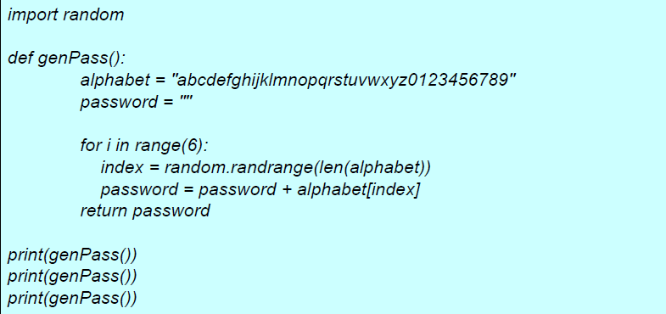
PPT PRESENTATION
Enjoy your stylish business and campus life with BIZCAM

Slide 3


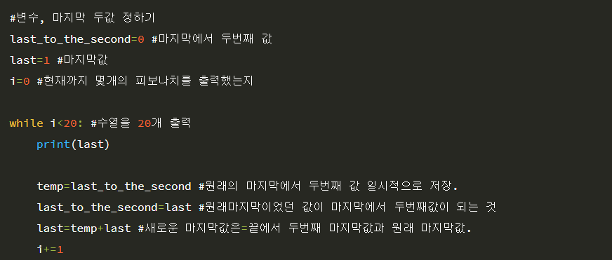
피보나치 수열
Enjoy your stylish business and campus life with BIZCAM

Slide 4

피보나치 수열
Enjoy your stylish business and campus life with BIZCAM

